Slide 1





Module 07- Working with Files
WWW.SELACLOUD.COM

Slide 2
Agenda
Open File
Reading file data
Writing to file
File Position
File Attributes
JSON

Slide 3
Open Files
file_object = open(filename, mode = 'r')
modes:
'r' - Opens a file for reading only. The file pointer is placed at the beginning of the file. This is the default mode.
'w' - Opens a file for writing. If file already exists it will be truncated, if not it will be created.
'a' - Opens a file for appending. The file pointer is at the end of the file if the file exists. If the file does not exist, it creates a new file for writing.
'r+' - Opens a file for both reading and writing. The file pointer will be at the beginning of the file
'w+' - Opens a file for both writing and reading. If file already exists it will be truncated, if not it will be created.
Notes:
Data and functionality bound together into one logical structure
In this part, we’ll introduce the basic concept, which will be taught in detail, later in this course.
The goal of this review is to avoid unnecessary confusion throughout the first lessons of the course.
For now, we can view the class as the placeholder of functions and non-local variables.
If a function is a block where Python code is written, than a class is a block where functions are written.

Slide 4
Close Files
file_object.close() - to close it and free up any system resources taken up by the file
file_object.closed – returns whether the file is already closed (True/False)
It is good practice to use the with keyword when dealing with file objects (context manger)
This has the advantage that the file is properly closed after its suite finishes, even if an exception is raised on the way.
It is also much shorter than writing equivalent try-finally blocks
with open('output.txt', 'w') as f:
f.write('Hi there!')
Notes:
A class is only a description
We can compare classes to an architect’s blueprint design.
Using the blueprint design we can create an object.
Essentially, a class describes an object, based on its properties and actions.
The object may be a real-world object that the application takes care of (for instance in banking system application, the class may describe a customer or interest rate), or a computer object (for instance, a data structure).
The class contains information about the object and functions that enable performing operations on the object such as changing its data, activating it on other objects, etc.

Slide 5
Reading data
file_object.readline()
reads a single line from the file a newline character (\n) is left at the end of the string
if f.readline() returns an empty string, the end of the file has been reached
file_object.readlines( ) – return a list containing the file content lines
file = open('somefile.txt', 'r’)
print (file.readlines()) #['first line\n', 'second line\n']

Slide 6
Reading data – cont’d
It is possible to read file data with read function
file_object.read(size) - reads some quantity of data and returns it as a string:
s = f.read(size)
size is an optional numeric argument. When size is omitted or negative, the entire contents of the file will be read and returned:
whole_data = file_object.read() - reads the entire contents of the file
Notes:
In this example
We declare a Student class – a class that describes a student.
Then, we can use Student as the type for a variable (see class Person).
A meaningful name should be chosen for each class.

Slide 7
File iterator
For reading lines from a file, you can loop over the file object. This is memory efficient, fast, and leads to simple code:
for line in file_object:
print (line)
Notes:
When we want to create an object (class instance) we need to use the keyword new .
new activates the procedure (function) that is responsible for the creation of the object.
Later in the course we’ll define that procedure ourselves.
tempPerson is declared as an instance (object) of class Person.

Slide 8
Writing to file
file_object.write(string) - writes the contents of string to the file
with open('out', 'w') as f:
f.write('This is a test\n')
Notes:
Data Members are the class internal variables
In this example class Person has two data members:
name
age
Each object has a unique copy of all data members
Objects of the same class have the same fields, as defined in their class definition.
However, each object has its own copy of the data members containing the object’s specific data.
In this example, every Person object has its own name and age.

Slide 9
File Position
tell() - returns current position in the file, in bytes from the beginning of the file.
The seek(offset, from=0) method changes the current file position.
The offset argument indicates the number of bytes to be moved.
The from argument specifies the reference position from where the bytes are to be moved:
io.SEEK_SET (0) – from the beginning of the file
io.SEEK_CUR (1) – from current file position
io.SEEK_END (2) – from the end of the file
offset must be zero for SEEK_CUR and SEEK_END in python 3.x
Notes:
Data and functionality bound together into one logical structure
In this part, we’ll introduce the basic concept, which will be taught in detail, later in this course.
The goal of this review is to avoid unnecessary confusion throughout the first lessons of the course.
For now, we can view the class as the placeholder of functions and non-local variables.
If a function is a block where Python code is written, than a class is a block where functions are written.

Slide 10
File object attributes
file.closed - Returns true if file is closed, false otherwise.
file.mode - Returns access mode with which file was opened.
file.name - Returns name of the file.
The Output:
"foo.txt“
False
w
fo = open("foo.txt", "w") print ("Name of the file: ", fo.name ) print ("Closed or not : ", fo.closed ) print ("Opening mode : ", fo.mode)

Slide 11
Labs 01-03

Slide 12

JSON
JSON (JavaScript Object Notation) is a lightweight data-interchange format that is widely used for transmitting and storing data. It is easy for humans to read and write, and it's also easy for machines to parse and generate. JSON is supported by many programming languages, including Python.
In Python, you can work with JSON using the built-in json module. This module provides functions for encoding (converting Python objects to JSON strings) and decoding (converting JSON strings to Python objects) data.
Let's start with an example of encoding a Python object to JSON. Consider a dictionary representing a person's information:

Slide 13
JSON Examples

Slide 14
JSON Examples
In the example above, we use the dumps() function from the json module to convert the person dictionary into a JSON string. The json_data variable stores the resulting JSON string. Notice that the keys and string values are enclosed in double quotes, as per the JSON syntax.
import json person = { "name": "John Doe", "age": 25, "city": "New York" } # Encode the dictionary to JSON json_data = json.dumps(person) print(json_data)

Slide 15
JSON Examples
In this example, we use the loads() function from the json module to convert the JSON string json_data into a Python dictionary. We can then access the values in the dictionary using the corresponding keys.
import json json_data = '{"name": "John Doe", "age": 25, "city": "New York"}' # Decode the JSON string to a dictionary person = json.loads(json_data) print(person["name"]) print(person["age"]) print(person["city"])
JSON is commonly used for exchanging data between a client and a server or for storing configuration settings. It is a versatile and widely supported format for data serialization.

Slide 16
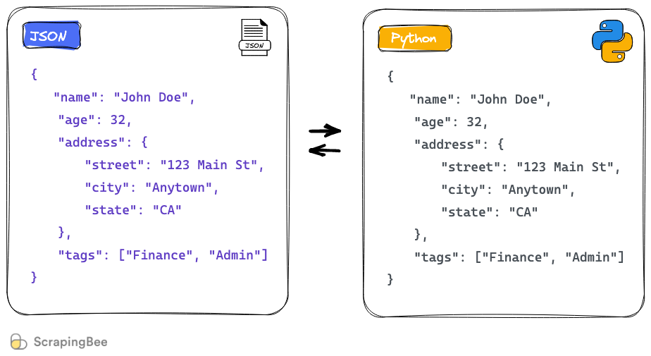
JSON string to Python object
You can use the json.loads method to easily convert this JSON string to a Python object:
import json json_string = """ { "name": "John Doe", "age": 32, "address": { "street": "123 Main St", "city": "Anytown", "state": "CA" }, "tags": ["Finance", "Admin"] } """ parsed_json = json.loads(json_string) print(parsed_json["address"]["street"]) # Output: 123 Main St
Now you can access any key/value the same way as you would in a Python dictionary. This is the conversion table used by Python while decoding JSON to a Python object:

Slide 17
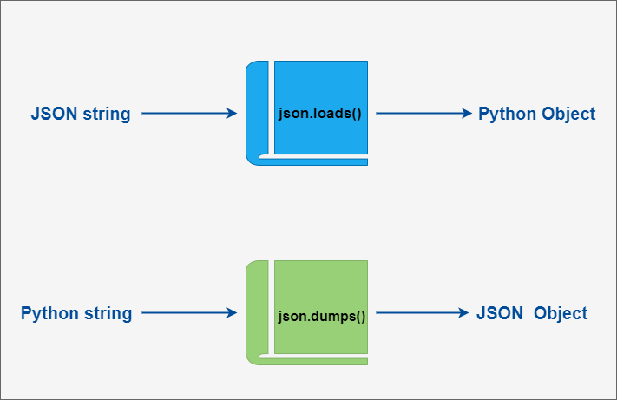
Python object to JSON string
Just like how the json package provides json.load and json.loads, it provides similar methods to "dump" a Python object to a string or a file. In this section, you will learn what these methods are and how to use them.
The json package contains the json.dumps method to convert a Python object to a JSON string. This is how it works:
import json profile = { "name": "John Doe", "age": 32, "address": { "street": "123 Main St", "city": "Anytown", "state": "CA" }, "tags": ["Finance", "Admin"] } json_string = json.dumps(profile) print(type(json_string)) # Output <class 'str'> print(json_string) # Output: '{"name": "John Doe", "age": 32, "address": {"street": "123 Main St", "city": "Anytown", "state": "CA"}, "tags": ["Finance", "Admin"]}'

Slide 18
Labs 04

